Slide 1
Leadership I for fire and ems: strategies for company success
Communications for the Company Officer

Slide 2
OBJECTIVES
The students will:
Describe different types or methods most commonly used to communicate.
Discuss what makes communication effective given different situations.
Identify organizational tattoos that prevent effective communication.

Slide 3
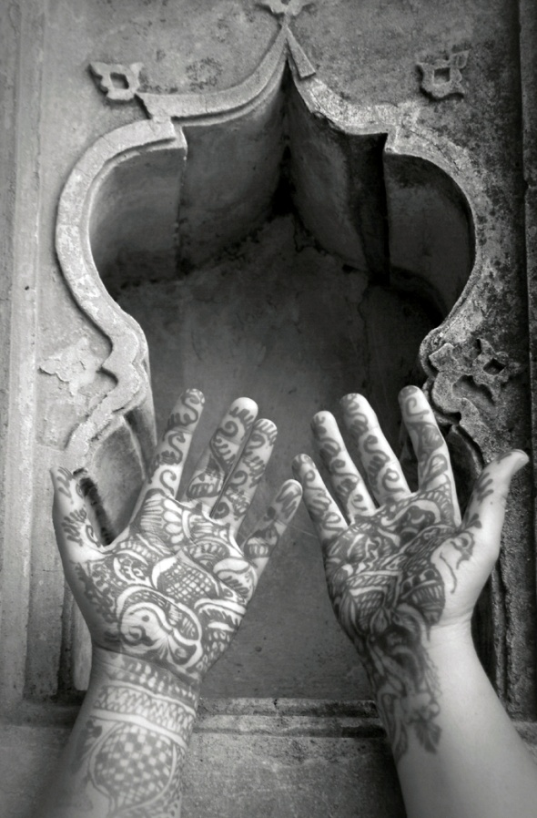
OVERVIEW
Types of Communication
Organizational Tattoos

Slide 4
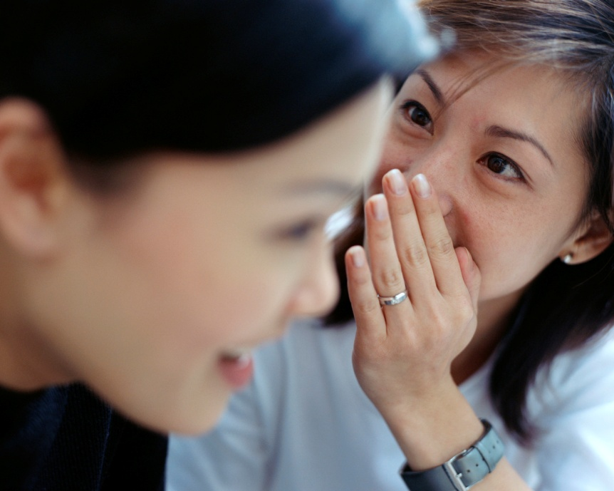
Types of Communication
Verbal:
Language
Vocabulary
-- Slang
-- Industry
Terminology
– Simply the words

Slide 5
Types of Communication (cont'd)
Nonverbal:
We send 65 percent of all messages nonverbally.
We say so much without saying a thing.

Slide 6
Types of Communication (cont'd)
Nonverbal:
Body language
-- Face
--Arms, hands,
-- Movement, posture
– How we stand or face each other
-- Males--typically 90-degree angles
-- Women--face-to-face

Slide 7
Types of Communication (cont'd)
Paraverbal--it's not what you say, but how you say it
Tone of voice
Volume
Enunciation
Sarcasm can be sensed
Emphasis on the wrong word can give different meaning
Pausing can change a meaning as well

Slide 8
Types of Communication (cont'd)
Written communication
Business writing
Report writing
Personnel documentation
Personal correspondence
Email
Social networking sites and blogs

Slide 9
WRITTEN COMMUNICATION
Business writing:
Company Officers (COs) need to know how to write a professional letter, memo, and formal thank you letter.

Slide 10
WRITTEN COMMUNICATION (cont'd)
Report writing:
Read by many people
Need to be:
-- Complete
-- Accurate
-- Factual
-- Legible
-- Consistent
-- Per policy
-- Objective, not subjective

Slide 11
WRITTEN COMMUNICATION (cont'd)
Personnel documentation:
"If you didn't write it down, it didn't happen."
Personal correspondence:
Personal notes.
Thank you notes.
Letters of commendation.
Best if hand written.
Legible.
Short, but from the heart.

Slide 12
WRITTEN COMMUNICATION (cont'd)
Email
Keep professional if at work
Grammar and spelling
No "texting" shorthand
Work email subject to the Freedom of Information Act (FOIA)
Social networking sites and blogs
Be careful
You're not anonymous

Slide 13
Activity CM.1 How Do You Communicate?

Slide 14
ORGANIZATIONAL TATTOOS
Informational monikers
Reputation
Behavior
Education
Association

Slide 15
ORGANIZATIONAL TATTOOS (cont'd)
Get a positive one:
Ethical
Fair
Good listener
Good trainer
Team player

Slide 16
ORGANIZATIONAL TATTOOS (cont'd)
Negative tattoos are destructive:
Opportunities can be missed.
Good ideas are discounted.
Bad ideas embraced.
Good people aren't allowed to grow fully.

Slide 17
ORGANIZATIONAL TATTOOS (cont'd)
How to get rid of organizational tattoos:
Stop behavior that got you there.
Allow tattoo to "fade."
Replace negative tattoo with positive one.
Supervisors must discourage placing negative tattoos on their people.

Slide 18
Activity CM.2 Organizational Tattoos in Practice

